Slide 1
Manage Your
Technical Debt
Make the case to manage technical debt in terms of business impact.

Slide 2
Table of Contents
3 Executive Brief
18 Phase 1: Identify Your Technical Debt
32 Phase 2: Measure Your Technical Debt
46 Phase 3: Manage Your Technical Debt
72 Works Cited

Slide 3
Manage Your Technical Debt
Make the case to manage technical debt in terms of business impact.
EXECUTIVE BRIEF

Slide 4

Analyst Perspective
There’s an iconic scene in I Love Lucy, where Lucy’s wrapping candies on a production line for an overbearing boss. Work that starts out easy becomes difficult, and then impossible, as a torrent of candies come down the line far faster than the workers can wrap them. Even as the workers are hiding (and eating) the candies they can’t wrap, the boss comes back, sees a clear work area, congratulates the team – and orders the line sped up.
If you don’t shed light on the true business impact of technical debt, it can overwhelm your team and your business.
Tech debt tends to drive a lot of IT work the business doesn’t see and that keeps things running smoothly. Efforts to properly pay back technical debt are deprioritized or ignored because they’re infrastructural and don’t clearly offer business benefits. The problem is the bill always comes due.
The goal isn’t to get rid of all your technical debt but to better balance tech debt payback with other business demands. At its core, technical debt is business risk, and it’s up to IT to help the business make an informed decision about which risks to mitigate and which risks to accept.
Use this blueprint to identify your technical debt, measure its business impact, and propose and implement solutions that can help you manage and pay back your technical debt.
But first, go watch that scene from I Love Lucy.
Manage technical debt to better govern risk.
Andrew Sharp Sr. Research Analyst, Operations Practice Info-Tech Research Group

Slide 5



Executive Summary
Your Challenge
Common Obstacles
Info-Tech’s Approach
You know you have technical debt – everyone does. But ask yourself the following:
Do you have a list of your critical technical debt?
Can you confidently speak to the business impact of technical debt?
Do you have a methodology and a business case to address technical debt that has an unacceptable level of impact on the business?
If you answered “no” to any of these questions, read on.
These obstacles get in the way of effective technical debt management:
IT doesn’t have the resources or authority to make needed changes to address the impact of tech debt and can’t make the case for improvement without good data on the problem.
Efforts to track technical debt get stuck in the weeds, don’t connect technical issues to business impact, and run out of steam.
Define and identify your technical debt, focusing on tech debt you think you can actually fix.
Conduct a streamlined and targeted business impact analysis to prioritize tech debt based on its ongoing business impact.
Identify opportunities to better manage technical debt and present those options to business decisionmakers, as needed.
Three key steps enable effective technical debt governance.
Technical debt is a type of technical risk, which in turn is business risk. IT should be a trusted advisor to business leaders making risk management decisions and must communicate the level of risk and options to manage that risk. It’s up to the business to decide whether to accept technical debt or mitigate it.

Slide 6



The technical debt lifecycle
Principal
Direct Costs
+
Strategic Impact
+
Uncertainty
Pay back
A cost is avoided in an IT environment, for the moment.
=
Business impact continues until the initial cost is addressed or the system carrying the debt is abandoned.
Interest
Messy code is deployed to meet a deadline.
Equipment refreshes are deferred.
Security vulnerabilities are left unpatched.
Machine learning algorithms are not analyzed for accuracy or bias.
Data is ungoverned; APIs don’t follow standards.
Broken service management processes are not fixed.
Training budgets are cut.
Old technologies are not replaced.
The initial cost avoidance leads to ongoing business impact (ongoing costs, user impacts, reduced flexibility, and increased risk).
Code is iteratively refactored until it meets acceptable standards.
Patches and updates are scheduled and applied.
New devices are purchased and deployed.
The legacy system is replaced.
A data governance program is developed and enforced.
A training and knowledge management program is developed.
Unused or little-used systems are retired.
New features are slower to code and more likely to break, limiting business agility.
EUDs are slow and hinder productivity.
Data is unusable for analytics or the results are badly flawed.
Integrations are difficult or impossible.
Reliance on expensive outside contractors; slow response, escalation, and resolution times.
A future upgrade becomes gradually more painful.

Slide 7
Tackle a mountain of technical debt
Technical debt describes the result of avoided costs that over time cause ongoing business impact. Tech debt creates friction for your IT and business staff; frustrates your customers; limits your flexibility, competitiveness, and resilience; and erodes business value.
Most organizations have a significant and growing technical debt portfolio.
Left unaddressed, tech debt can become an existential threat that risks your organization’s ability to effectively compete and serve its customers. Businesses that fail to properly manage their technical debt will be at a significant competitive disadvantage.
As an IT leader it’s your role to help the business better understand the risks introduced by technical debt, in terms of its ongoing business impact, and the options available to address it. This allows business leaders to make better decisions to pay back or hold technical debt.
“Poor management of tech debt hamstrings companies’ ability to compete.”
Source: McKinsey Digital

Slide 8
Technical debt is expensive and ineffectively managed
Resolving or minimizing the impact of aging systems is seen as IT’s problem to solve, even when IT has no resources or authority to make needed changes.
Deferred project work is pushed over to operations, sometimes with little visibility or hand-off, where it gets deprioritized and lost.
The effort of keeping legacy systems stable, patched, and updated drains away time from longer-term planning exercises.
Though business leaders are often aware that aging systems are an obstacle to realizing business value, they don’t greenlight fixes because of other, more urgent priorities or because IT isn’t trusted to deliver an effective solution.
Building a case to address technical debt can be difficult because the technical problems are complex and difficult to translate into business impact.
A well-intentioned effort to track every technical debt is doomed to failure. Track just the technical debt you intend to fix. It’s better live with some technical debt than to replace it.
On average, respondents said that 25% of their development time went toward technical debt management activities.
25%
but,
93% of respondents had no way to systematically track and manage the technical debt that was absorbing all that time.
93%
Source: Martini, et al.

Slide 9
Unlock business value by managing your technical debt
IT Benefits | Business Benefits
Manage the chaos and disorder created by technical debt to deliver more reliable, available, and serviceable IT systems and applications. Conduct a holistic analysis of your organization’s technical debt to identify the debt generating unacceptable business impacts. Identify options to reduce technical debt, and use your technical debt business impact analysis to make the case for funding and resources. Build a technical debt register to maintain visibility on tech debt in your environment. | Identify strategic solutions to replace or manage legacy technology that will enable the business flexibility and resilience required to outperform your competitors. Make better resource allocation decisions with better information on the true business cost of deferred IT maintenance.

Slide 10
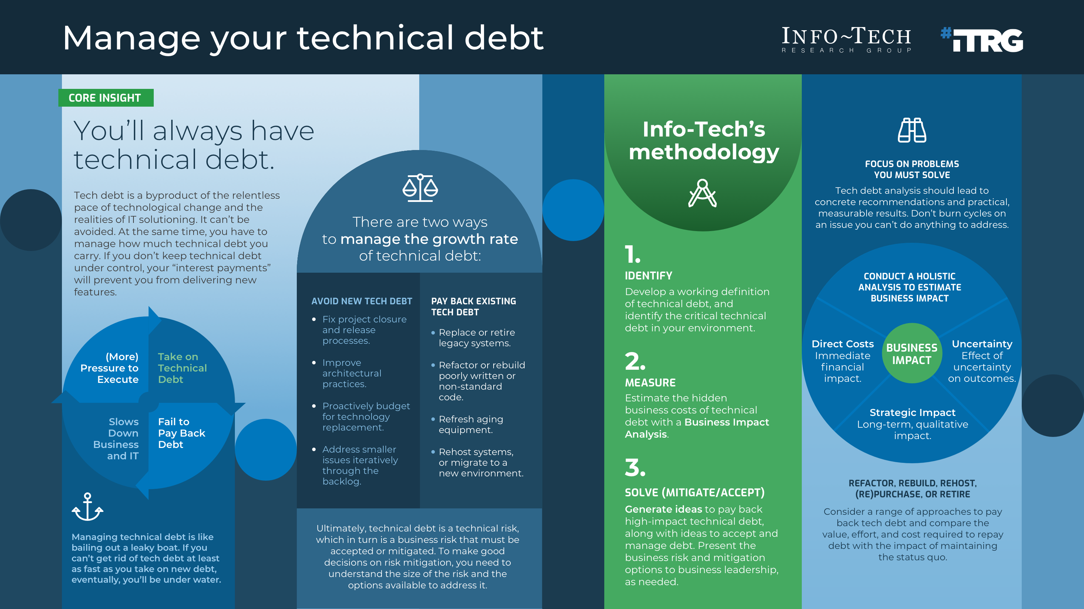

Slide 11
Insight summary
Three key steps enable effective technical debt governance.
Technical debt can, and should, be actively governed in a way that delivers durable value to the business. Every IT organization must identify, measure, and manage their technical debt to govern technical debt effectively.
Focus on solving the problems you need to address.
Don’t make your tech debt assessment a philosophical exercise, a confessional booth, or an appeal for sympathy. Do this exercise because you have a problem that needs to be better understood to be fixed. Analyzing technical debt only has value in that the analysis can help the business and IT make better risk management and resource allocation decisions. It is a tool to help you get to where you need to be – it is not an end in itself.
Use a comprehensive and more-objective impact analysis.
It’s often challenging to identify a direct financial cost for technical debt. Consider direct costs, but also assess categories of impact that can have a long-term effect on your business: lost customer, staff, or business partner goodwill; limited flexibility and resilience; health, safety, and compliance impacts. Use more-objective measures to track subjective impact. For example, consider the number of customers who could be significantly affected by each tech debt in the next quarter.
Accepted, not ignored.
Not every technical debt in your environment can – or should – be addressed right away. A decision by the business to avoid addressing technical debt now is the business’ acceptance of the risk. This can be an appropriate and acceptable outcome. Of course, the debt doesn’t go away. Track your remaining technical debt and the options available to mitigate or address the risks associated with technical debt.

Slide 12
Manage technical debt
 | Phase 1: Identify Technical Debt | Phase 2: Measure Technical Debt | Phase 3: Manage Technical Debt
Phase Steps | 1.1 Define technical debt 1.2 Identify technical debt items | 2.1 Create impact scoring criteria 2.2 Estimate the business impact of technical debt | 3.1 Identify action items to reduce technical debt 3.2 Track and control technical debt
Phase Outcomes | Identify sources of technical debt in your environment. Consolidate and narrow the initial list and select five to ten tech debt items that are highest impact/risk. | Develop business impact criteria to assess the business impact of identified technical debt. Prioritize technical debt items based on business impact. | Brainstorm projects and action items that can address technical debt. Develop a proposal to manage technical debt. Implement management practices that help you better manage technical debt.

Slide 13

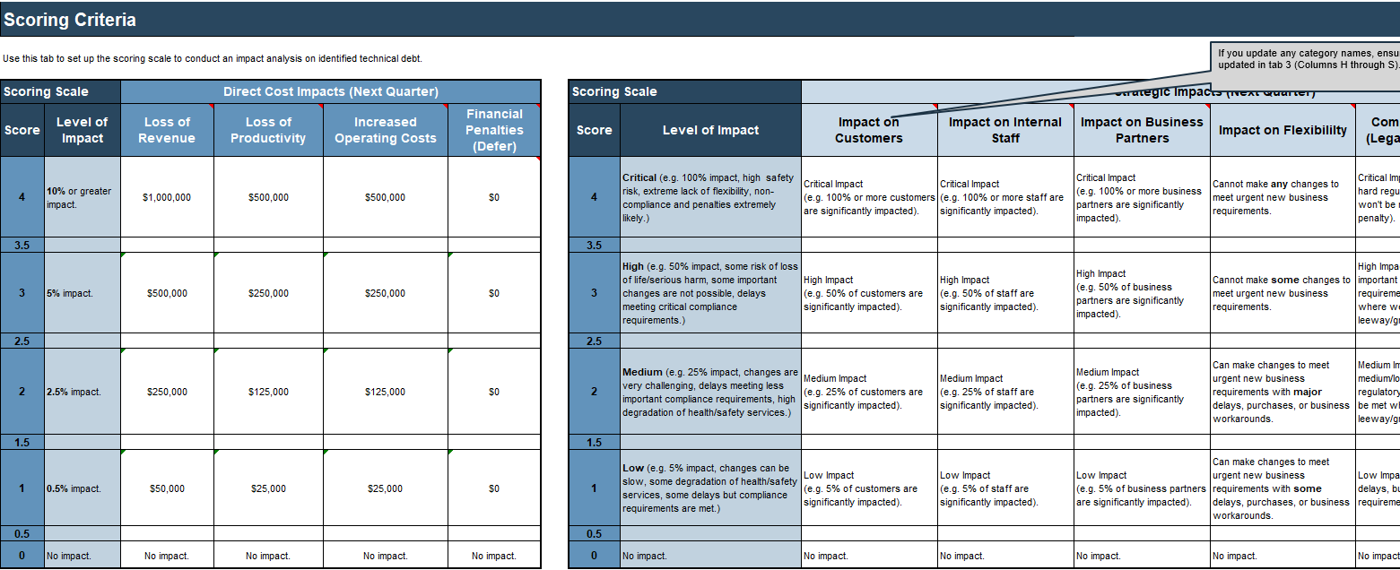
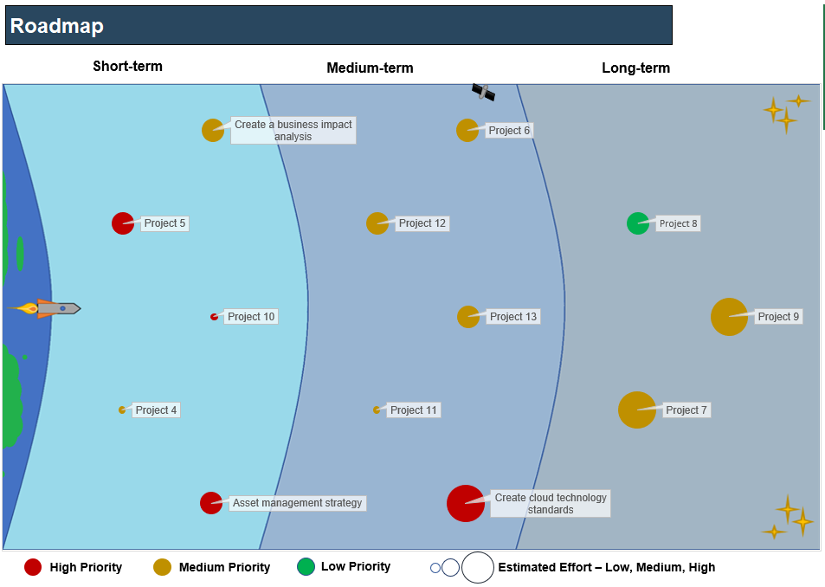
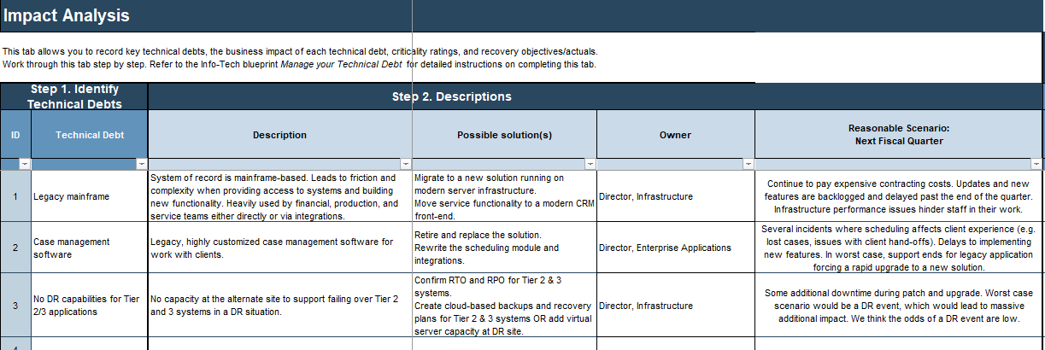
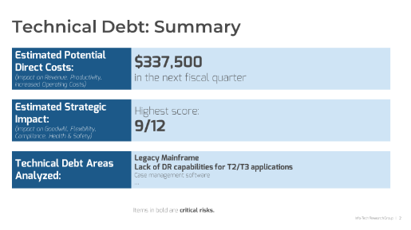
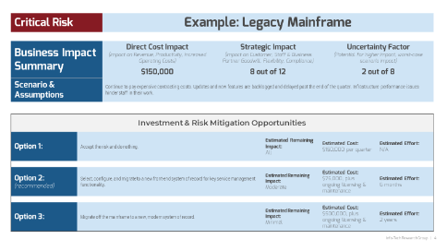
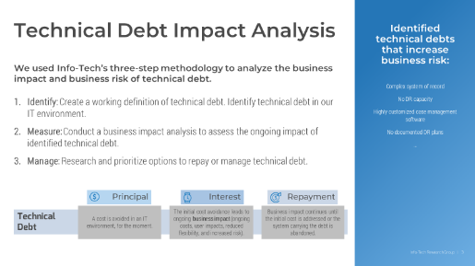
Blueprint deliverables
Key deliverable:
Each step of this blueprint is accompanied by supporting deliverables to help you accomplish your goals:
Technical Debt Executive Summary Presentation
Communicate the risk of technical debt and approaches to address it to an executive audience with this simple and slick overview template.
Technical Debt
Business Impact Analysis
Roadmap Tool
Document technical debts, create a business impact scoring scale, and assess the impact of each technical debt on the business.
Document action items and projects to address technical debt. Estimate risk reduction, effort, and cost. Create a visual roadmap.

Slide 14
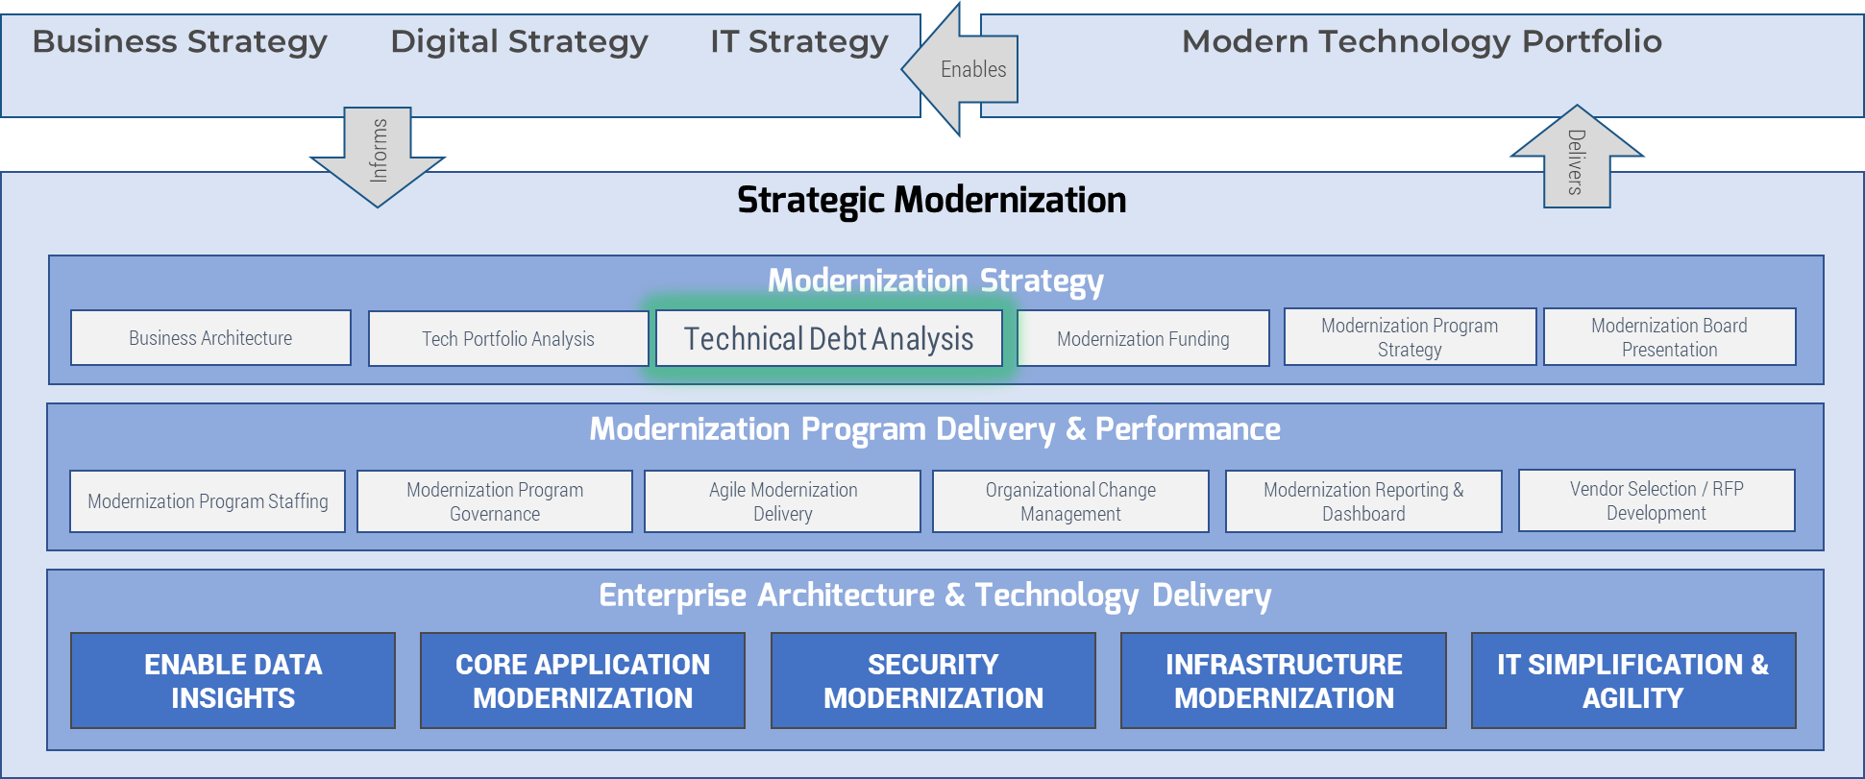
Analyze technical debt to inform your modernization strategy
Chart a path to the future that accounts for the constraints of today.
Major modernization initiatives, including digital transformation, can enable tremendous business value, but technical debt can stand in the way of truly transformative, structural changes.
Old technology may not enable the capabilities and functionality required to digitize business processes.
Use a modernization strategy to make the case for eliminating technical debt.
The constraints introduced by technical debt on modernization are a type of business impact. Use this blueprint to estimate and communicate the impact of technical debt as an obstacle to modernization and inform your modernization strategy with that analysis.
Key Info-Tech Modernization Blueprints: | Modernize Your Applications | Build an Infrastructure Roadmap | Modernize Data Architecture

Slide 16

Guided Implementation
A Guided Implementation (GI) is a series
of calls with an Info-Tech analyst to help implement our best practices in your organization.
A typical GI is between 6 to 10 calls over the course of 3 to 6 months.
What does a typical GI on this topic look like?
Phase 1
Identify Technical Debt
Phase 2
Measure Technical Debt
Phase 3
Manage Technical Debt
Call #1: Scope requirements, objectives, and your specific challenges.
Call #3: Create and document business impact scoring scales that are relevant to your organization.
Call #6: Identify and prioritize actions to address technical debt and review the executive summary template.
Call #2: Review and document sources of technical debt in your environment.
Call #4: Identify reasonable scenarios for impact scoring and begin the scoring exercise.
Call #7: Review the draft executive summary. Identify process improvements to slow down the technical debt “production line.”
Call #5: Review the results of the scoring exercise.
Info-Tech Research Group | 16

Slide 17
Workshop Overview
Contact your account representative for more information. workshops@infotech.com 1-888-670-8889
 | Day 1 | Day 2 | Day 3 | Day 4 | Day 5
Activities | Define Technical Debt | Measure Technical Debt | Build a Roadmap | Manage Technical Debt | Next Steps and Wrap-Up (offsite)
 | 1.1 Develop a working definition for technical debt. 1.2 Discuss your organization’s technical debt risk. 1.3 Identify 5-10 high-impact technical debts to structure the impact analysis. | 2.1 Review and modify business impact scoring scales. 2.2 Identify reasonable scenarios to structure the impact analysis. 2.3 Apply the scoring scale to identify the business impact of each technical debt. | 3.1 Finish the impact analysis. 3.2 Roll up the results of the impact analysis, and identify critical (highest impact) technical debts. 3.3 Brainstorm projects and action items to manage and pay back critical technical debt. 3.4 Prioritize projects and action items to build a roadmap. | 4.1 Use the items on the roadmap to identify different courses of action to address critical technical debt. 4.2 Identify three possible courses of action to pay back each critical technical debt. 4.3 Identify immediate next steps to manage remaining tech debt and limit the introduction of new tech debt. | 5.1 Complete in-progress deliverables from previous four days. 5.2 Set up review time for workshop deliverables and to discuss next steps.
Deliverables | Goals, opportunities, and constraints related to tech debt management A list of technical debt | Business impact scoring scales Scenarios to support the impact analysis Preliminary technical debt impact scores | Technical debt business impact analysis Technical debt management roadmap | Options for technical debt pay back Technical debt executive summary Immediate next steps to manage technical debt | Workshop summary and overview presentation Finalized outputs from all workshop working sessions

Slide 18
Phase 1
This phase will walk you through the following activities:
Define, identify, and organize your technical debt in preparation for the technical debt impact analysis.
This phase involves the following participants:
Tech Debt Exercise Facilitator
IT Management
IT SMEs
Optional:
Business stakeholders
Identify Your Technical Debt
Phase 1
Phase 2
Phase 3
1.1 Define “technical debt”
1.2 Identify technical debt in your environment
2.1 Create impact scoring criteria
2.2 Estimate the business impact of technical debt
3.1 Identify action items to reduce technical debt
3.2 Track and control technical debt

Slide 19
Step 1.1
Insights & Outcomes
Define “technical debt”
Develop a shared working understanding of the technical debt metaphor and discuss how the concept applies in your IT environment.
This step will walk you through the following activities:
Review Info-Tech’s definition of technical debt.
Understand the roles that IT and the business play in proper technical debt management.
Discuss your business’ technical debt risk and how you manage that risk currently.
This step involves the following participants:
Tech Debt Exercise Facilitator
IT Management
IT SMEs
Optional:
Business stakeholders
Phase 1:
Identify Your Technical Debt
1.1 Define “technical debt”
1.2 Identify technical debt in your environment

Slide 20
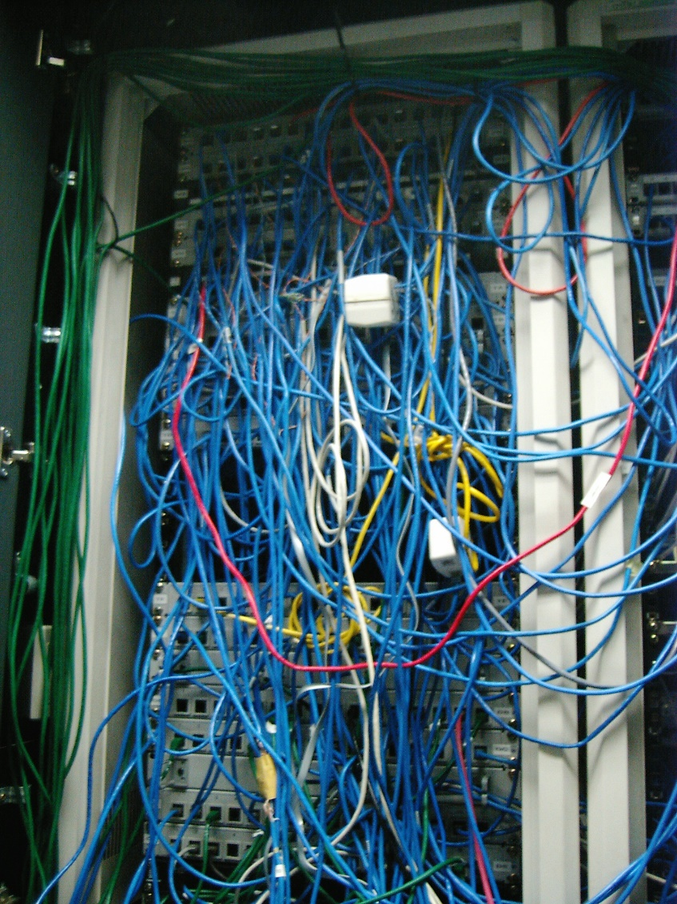
Confront the business cost of past decisions
Inefficient and incomplete code, fragile legacy systems, broken processes, messy data, wiring that would make a rat feel at home.
You have them all.
What do they have in common, besides their contribution to your stress headache?
They are the result of past decisions to meet business demands by deferring a solution to problems. These problems now increase business risk and erode business value. The business may not know about these problems, or if they do, they see them as IT’s problems to solve.
So, what to do? Change the conversation. Don’t talk about IT’s problems – talk about your business’ technical debt. This “technical debt” must be effectively managed to deliver durable value to your business.
This Info-Tech blueprint will give you the methodology, tools, and templates you need to identify, measure, and manage your organization’s technical debt.

Slide 21
What is technical debt?
Technical debt is the business impact and costs related to past cost avoidance around IT systems and services. Tech debt is a metaphor and a storytelling device that can help explain the long-term consequences, costs, and risk introduced by prioritizing short-term cost avoidance over functionality, reliability, availability, and serviceability.
It’s a concept originally advanced by pioneers of the Agile software development movement to describe the tradeoffs between speeding development along and building workable and maintainable code.
A debtor borrows some amount of money.
The debtor pays interest on the debt.
Interest continues to be owed until the debt and accrued interest is repaid or the debtor declares bankruptcy.
Financial Debt
Principal
Interest
Pay back
Technical Debt
A cost is avoided in an IT environment, for the moment.
The initial cost avoidance leads to ongoing business impact (ongoing costs, user impacts, reduced flexibility, and increased risk).
Business impact continues until the initial cost is addressed or the system carrying the debt is abandoned.
A code development example:
“We haven’t added all the features and the code’s messy, but the product launches tomorrow. We can’t afford to delay launch. Ship now and we’ll deal with the consequences later.”
“The missing features are creating a lot of manual work for the sales team, and we’re running into performance problems related to inefficient code.”
“We tracked and assigned the missing features and code issues in the backlog and we’re taking an iterative approach to improvement.

Slide 22
Technical debt explains business impact
The “interest” or “debt service” portion of the technical debt metaphor can be used to explain the ongoing business impact of avoided costs in all areas of IT.
Principal
Interest
Pay back
A cost is avoided in an IT environment, for the moment.
The initial cost avoidance leads to ongoing business impact (ongoing costs, user impacts, reduced flexibility, and increased risk).
These additional costs continue until the initial cost is addressed or the system carrying the debt is abandoned.
For example:
Messy code is deployed to meet a deadline.
Equipment refreshes are deferred.
Security vulnerabilities are left unpatched.
Machine learning algorithms are not analyzed for accuracy or bias.
Data is ungoverned; APIs don’t follow standards.
Service management processes are not fixed.
Training is not budgeted.
Old technologies are not replaced.
For example:
New features are slower to code and more likely to break, limiting business agility.
EUDs are slow and hinder productivity.
Data is unusable for analytics or the results are badly flawed.
Integrations are difficult or impossible.
Reliance on expensive outside contractors; slow escalation and response times.
A future upgrade becomes gradually more painful.
For example:
Code is iteratively refactored until it meets acceptable standards.
Patches and updates are scheduled and applied.
New devices are purchased and deployed.
The legacy system is replaced.
A data governance program is developed and enforced.
A training and knowledge management program is developed.
Unused or little-used systems are retired.

Slide 23

Technical debt is a business risk
Use a holistic assessment of the “interest” paid on technical debt to quantify and prioritize risk and enable the business to make better decisions.
Technical debt is an IT risk, which in turn is a category of business risk.
The business must decide how to manage business risk.
At the same time, business decision makers may not be aware of technical debt or be able to translate technical challenges into business risk. IT must help the business make decisions around IT risk by describing the risk of technical debt in business terms and by outlining the options available to address risk.
Measure the ongoing business impact (the “interest” paid on technical debt) to establish the business risk of technical debt. Consider a range of possible impacts including direct costs; lost goodwill; impaired flexibility; and health, safety, and compliance impacts.
When weighing the business may choose to accept the risk of technical debt if the cost of addressing the debt outweighs the benefit. But it’s critically important that the business accepts that risk – not IT.

Slide 24

Technical debt must be analyzed by IT
Use a systematic, deliberate analysis to help your business make sound decisions around risk.
Do:
Use the technical debt metaphor to explain the impact of technical challenges on the business.
Identify your business’ specific technical debts.
Estimate the business impact of significant technical debts.
Brainstorm and prioritize options to address technical debt.
Iteratively address technical debt wherever possible, and seek sponsorship, funding, and resources from the business where necessary.
Adopt management practices that enable your teams to track and address technical debt on an ongoing basis.
Do not:
Try to analyze every tech debt in your environment.
Get bogged down in deep technical analysis at the outset. You need just enough technical analysis to be able to reasonably estimate business impact.
Choose a solution before you identify the business impact.
Ask business stakeholders about the business impact of technical debt without developing your own estimates first.
Expect to be able to “pay back” all your business’ technical debt right away. Some problems aren’t worth fixing right now – or at all.

Slide 25
1.1.1 Discuss your technical debt risk
Input | Output
This slide deck | Document: Potential sources of technical debt. Current tech debt management practices. Past obstacles to address tech debt. Current opportunities to address tech debt.
Materials | Participants
Whiteboard and markers | IT Management IT SMEs Optional: Business stakeholders
30 minutes
1. Assign a facilitator to present the previous slides. Then take up the questions below.
2. Assign a participant to take notes (on a whiteboard or in a Word document).
What are some examples of technical debt in your environment, and how does technical debt affect your business? (Keep this discussion high level, for now. You’ll define your technical debt and measure its impact in more detail later.)
Is the business aware of its technical debt?
What are you currently doing to manage technical debt? (E.g. do you track technical debt in a backlog, have a replacement budget, or track recurring problems?)
What obstacles have you faced in the past when trying to address this technical debt?
Why is now a good time to address this technical debt?
Will you need to ask the business for resources to address this technical debt? What could happen if you do not secure needed resources?

Slide 26
Step 1.2
Insights & Outcomes
Identify technical debt in your environment
Focus on technical debt that has a significant impact on the business and that you’ll build a plan to address.
This step will walk you through the following activities:
Review common examples of technical debt.
Identify technical debt in your organization.
Narrow the scope to five to ten high-impact technical debt items.
This step involves the following participants:
Tech Debt Exercise Facilitator
IT Management
IT SMEs
Phase 1:
Identify Your Technical Debt
1.1 Define “technical debt”
1.2 Identify technical debt in your environment

Slide 27
Review these examples of technical debt
Do you have any of these challenges?
Applications
Inefficient or incomplete code
Fragile and/or obsolete systems of record that limit the implementation of new functionality
Out-of-date IDEs or compilers
Unsupported applications
Data & Analytics
Data presented via API does not conform to chosen standards (EDI, NRF-ARTS, etc.)
Poor data governance
No transformation between OLTP and the data warehouse
Heavy use of OLTP for reporting
Lack of AI model & decision governance, maintenance
End-User Computing
Aging and slow equipment
No configuration management
No MDM/UEM
Security
Unpatched/unpatchable systems.
Legacy firewalls
No data classification system
“Perimeter” security architecture
No documented security incident response
No policies, or unenforced policies
Operations
Incomplete, ineffective, or undocumented business continuity and disaster recovery plans
Insufficient backups or archiving
Inefficient MACD processes
Application sprawl with no record of installed applications or licenses
No ticketing or ITSM system
No change management process
No problem management process
No event/alert management
Infrastructure
End-of-life/unsupported equipment
Aging power or cooling systems
Water- or halon-based data center fire suppression systems
Out-of-date firmware
No DR site
Damaged or messy cabling
Lack of system redundancy
Integrated computers on business equipment (e.g. shop floor equipment, medical equipment) running out-of-date OS/software
Project & Portfolio Management
No project closure process
Ineffective project intake process
No resource management practices
“This isn’t a philosophical exercise. Knowing what you want to get out of this analysis informs the type of technical debt you will calculate and the approach you will take.”
Scott Buchholz, CTO Deloitte Government & Public Services Practice
The Wall Street Journal, 2015

Slide 28
Structure technical debt for analysis
Granular Approach
Tech Debt:
Unpatchable system
IMPACT
Lump together or break apart?
Tech Debt:
Single Label Domain
IMPACT
You can group loosely related technical debts together (a “bucket approach”) or score each item on its own (the “granular approach). Use the pros and cons below to decide how best to structure your technical debt for analysis.
Tech Debt:
Undocumented IRP
IMPACT
 | Bucket Approach | Granular Approach
Pros | With just a few large buckets, the impact analysis can go faster. Each item is more likely to have business impact. | Can be easier to score impact because each item is clearly defined.
Cons | Consider many different factors at once when analyzing impact. Can be more challenging to identify the impact of items in each bucket on their own. | Granular issues may not be significant enough to register business impact on their own. “In the weeds”; can take more time if there are lots of individual tech debts identified.
Bucket Approach
Unpatchable
systems
Undocumented
IRP
Minimal use of
group policy
No alert
or event
management
No PAM
Be practical and focus on the objective.
At the end of the day, remember the case you’re trying to make and choose an approach you think will help you make the case. Avoid burning cycles debating the merits of one approach over the other. You can quickly repeat the impact analysis if you find that you need an approach that is more granular or less in the weeds!
IMPACT
Security
Tech Debt Bucket

Slide 29
1.2.1 Identify your technical debt
Input | Output
Participant views on organizational tech debt | Initial list of tech debt
Materials | Participants
Whiteboard Sticky notes | Tech Debt Exercise Facilitator IT Management IT SMEs
30-60 minutes
Ask participants to brainstorm your organization’s sources of tech debt on their own ahead of this session. Focus on technical debt that participants believe can and should be paid back.
Hand out sticky notes to participants. Ask each participant to take five minutes to write down sources of technical debt in your IT environment. Write one tech debt per sticky note.
In general, keep the focus on technical debts you want to build a case to fix. Don’t just bring up problems. Bring up problems you can and need to solve!
Once the five minutes are up, ask participants to bring their sticky notes to the whiteboard and to present and explain each.
Consolidate the list by grouping related sticky notes together.

Slide 30
1.2.2 Select tech debt for your impact analysis
Input | Output
Initial list of technical debt | 5 -10 high-impact technical debts to include in the impact analysis
Materials | Participants
Whiteboard or flip chart paper | Tech Debt Exercise Facilitator IT Management IT SMEs
30 minutes
Start with the end in mind. You will analyze the business impact of each technical debt you identify and use that analysis to communicate risk to the business, and potentially, to make the case for funds and resources.
Aim for five to ten technical debts that have the highest impact on your business.
As you narrow down the list, consider:
Organizational focus: What technical debts stand in the way of current organizational priorities?
Resource requirements: What tech debts are large enough that you'll need to justify a project to address them?
Reverse engineering: You or your team may have certain solutions in mind already. Conducting a business impact analysis for tech debt that the solution might address can help make the case.
Recent problems: Were there specific technical debts at the root of recent, highly visible IT incidents?
Level of impact: Consider whether the direct costs, strategic impact, and uncertainty are significant enough to determine if a particular tech debt item is impactful enough. If a particular item isn’t impactful enough, consider combining items using the “bucket approach.”
Grief index: Which tech-debt-related issues are causing you the most grief?

Slide 31

1.2.2 Add tech debt to the Impact Analysis Tool
Input | Output
5-10 high-impact technical debts to include in the impact analysis | A populated copy of the Business Impact Analysis Tool
Materials | Participants
Technical Debt Business Impact Analysis Tool Projector or screensharing capabilities | Tech Debt Exercise Facilitator IT Management IT SMEs
30 minutes
Add the identified tech debts to tab 3 of your copy of the Technical Debt Business Impact Analysis Tool.
Record the following:
Give each tech debt a short name.
Add short descriptions for each technical debt. What exactly is this technical debt? What IT services does it affect? What lines of business?
Write down any possible solutions that have already been identified. Don’t brainstorm new solutions – just track existing ideas.
Identify any internal or external technical SMEs for each debt.
Identify who “owns” the debt, if possible. This should be an accountable role for each technical debt item, likely at the senior leadership level.
Download the Technical Debt Business Impact Analysis Tool

Slide 32
Phase 2
This phase will walk you through the following activities:
Conduct a technical debt business impact analysis.
This phase involves the following participants:
Tech Debt Exercise Facilitator
IT Management
IT SMEs
Measure Your Technical Debt
Phase 1
Phase 2
Phase 3
1.1 Define “technical debt”
1.2 Identify technical debt in your environment
2.1 Create impact scoring criteria
2.2 Estimate the business impact of technical debt
3.1 Identify action items to reduce technical debt
3.2 Track and control technical debt

Slide 33
Step 2.1
Insights & Outcomes
Create Impact Scoring Criteria
Create a more-objective scoring scale that can capture and compare the impact of technical debt in different areas of IT.
This step will walk you through the following activities:
Identify relevant categories of business impact.
Define a business impact scoring scale.
This step involves the following participants:
Tech Debt Exercise Facilitator
IT Management
IT SMEs
Phase 2:
Measure Your Technical Debt
2.1 Create impact scoring criteria
2.2 Estimate the business impact of technical debt

Slide 34
Conduct a tech debt business impact analysis
BIAs have a measurable impact on appropriate spending
Too many organizations avoid a BIA because they see it as onerous or unneeded.
% Indicated Their BCP Is Cost Effective
+27%
A well-managed BIA is straightforward, and the benefits are tangible.
A business impact analysis (BIA) is an operational analysis, prioritization, and solution design exercise. “BIA” also refers to the document that contains the results of this exercise.
BIAs are commonly used in business continuity and disaster recovery planning to identify the business impact of potential disruptions and to develop right-sized solutions and recovery objectives aligned to the impact of downtime.
In this phase, we’ll use a BIA to assess the ongoing business impact of your technical debt.
86%
59%
No BIA
With a BIA
Can I get away with not doing a BIA?
Selecting a solution before you understand the problem is a persistent antipattern. A BIA is a critical step in understanding and validating the extent of the problems you need to solve. Without properly understanding the business problem, it’s easy to spend the proverbial hundred dollars to fix a one-dollar problem.
Source: Info-Tech Research Group; N=70
A BIA enables you to identify appropriate spend levels, maintain executive support, and prioritize projects and action items for a more successful outcome.

Slide 35
Develop impact scoring scales
Info-Tech uses an impact analysis tool designed to capture tech debt impact in the next fiscal quarter, because:
One quarter is a long enough timeframe to establish impact.
The next quarter is near enough in the future to develop a reasonable and defensible estimate.
We can extrapolate from these estimates to develop an estimate over a longer time frame.
You can use a different time frame (such as your busiest quarter or a longer or shorter period of time) if you have a compelling reason to do so. However, we still suggest you conduct the analysis for one time period.
A good impact scoring rubric is:
Appropriate and relevant to your business.
Based on more-objective measures.
Comprehensive and holistic but not over complicated.
Defined in a way that enables comparison of scores in different impact categories.
Explainable to stakeholders.
Flexible enough to assess different tech debts and a wide range of impact.
We recommend you start with the scoring scale in Info-Tech’s Technical Debt Business Impact Analysis Tool and modify this to scale to meet your own business requirements.
Info-Tech Best Practice
Evaluate just the categories of impact that are relevant to your organization. Adjust the language in the scoring scales to reflect your own (e.g. “clients” or “members” instead of “customers).

Slide 36
Calibrate direct cost impact scales
Score | Direct Costs
4 | 10% or greater impact.
3 | 5% impact.
2 | 2.5% impact.
1 | 0.5% impact.
0 | No impact.
Calibrate Info-Tech’s direct cost scoring scale to measure a range of impact that can apply to your entire business.
Consider each of the following categories of direct cost impact and ignore any categories not relevant to your organization. By default, the Info-Tech tool sets maximum impact (a score of 4) at 10% of the total in any given direct cost category and scales down based on the table at right.
Loss of Revenue: Use the most recent revenue numbers at your disposal. Find quarterly revenue, then divide by ten for 10% of quarterly revenue. This will be the top end of the scoring scale.
Loss of Productivity: Proxy for lost workforce productivity using payroll numbers. Estimate the company’s fully loaded payroll for a given quarter, then divide by 10 for 10% of quarterly productivity. This will be the top end of the scoring scale.
Increased Operating Costs: Use the productivity scale, unless there’s a clear example of significantly higher operating costs that couldn’t be captured by the productivity scale. Use the maximum cost in that example as the high end of the impact scoring scale.
Financial Penalties: If there are known financial penalties (e.g. due to failure to meet SLAs or other contractual obligations), set the highest possible penalty as a score of 4.

Slide 37
Create strategic impact scales
Score | Level of Strategic Impact
4 | Critical (e.g. 100% impact, high safety risk, extreme lack of flexibility, non-compliance and penalties extremely likely)
3 | High (e.g. 50% impact, some risk of loss of life/serious harm, some important changes are not possible, delays meeting critical compliance requirements)
2 | Medium (e.g. 25% impact, changes are very challenging, delays meeting less important compliance requirements, high degradation of health & safety services)
1 | Low (e.g. 5% impact, changes can be slow, some degradation of health/safety services, some delays but compliance requirements are met)
0 | No impact.
Measure technical debt’s long-term impact.
The longest lasting impact tends to be difficult to translate to direct dollar costs. Conduct a more-objective assessment to assess long-term strategic impact to the business.
Impact on Customers: By default, the customer impact scale is based on the percent of your total customer base impacted. You can also modify this scale to include severity of impact or alter it to identify the maximum number of customers that would be impacted (if less than 100% of all the organization’s customers). Use language relevant to your organization (e.g. clients, members, or patients).
Impact on Staff: Measures the percent of staff significantly impacted by the technical debt.
Impact on Business Partners: Measures impact based on the number of partner organizations significantly impacted affected. Define who your business considers a business partner (e.g. suppliers, peer organizations, contractors, franchisees).
Impact on Business Flexibility: Measures the extent to which technical debt could present challenges to delivering changes (e.g. new features, functionality, access) needed by the business or IT.
Impact on Health & Safety: Measures the extent to which technical debt increases the risk to health & safety of staff, customers, and the general public. At the low end of the scale, consider degradation of health & safety services and controls.
Impact on Compliance: Describes a range of possible compliance-related impacts. Consider whether you’d expect to receive leeway or a grace period from the entity that requires evidence of compliance.

Slide 38
Use uncertainty factor scales
Uncertainty in a Business Impact Analysis
Assess additional impact.
Unlikely – Low or No Impact
Likely – Some Impact
Unlikely – High Impact
When we assess the direct cost and strategic impact in the next fiscal quarter, we must choose a reasonable scenario for our assessment. For some technical debts where the concern is very high-impact, low-probability events, a reasonable assessment might show that the near-term direct cost and strategic impact is fairly low.
We capture the additional, potential risk of high-impact, low-probability events as follows.
Use Info-Tech’s uncertainty factor scoring scale to assess:
Additional impact in a worst-case scenario.
The chance of additional impact above and beyond what is outlined in the direct costs and strategic impact categories.
A reasonable scenario used for scoring
Level of Impact
Additional impact in a worst-case scenario
The chance of additional impact
All possible scenarios, arranged from least to most impactful

Slide 39
2.1.1 Develop impact scoring scales
Input | Output
Your populated copy of Info-Tech’s Technical Debt Business Impact Analysis Tool | Updated business impact scoring scale
Materials | Participants
Your copy of Info-Tech’s Technical Debt Business Impact Analysis Tool Projector or screensharing capabilities | Tech Debt Exercise Facilitator IT Management IT SMEs
30 minutes
Work through the scoring scales in your pre-populated copy of the Technical Debt Business Impact Analysis Tool.
Review each section of the scoring scale:
Are direct costs relevant for the technical debts identified? Eliminate any categories that are not relevant (we recommend you hide the column). Set a dollar estimate for maximum impact (score of 4) in each relevant column. The rest of the scoring scale will auto-populate.
Identify which strategic impacts are relevant to the impact analysis, and again, hide any irrelevant columns. Update language in the scoring scale to reflect your organization’s language.
Review the uncertainty scoring scales.

Slide 40
Step 2.2
Insights & Outcomes
Measure Your Technical Debt
Develop a reasonable and more-objective assessment of the business impact of technical debt and use this assessment to focus attention and effort on the technical debt that has the greatest impact on the business.
This step will walk you through the following activities:
Identify a reasonable scenario for each technical debt.
Assess the business impact of selected technical debt, in the reasonable scenario identified, in the next quarter.
Sort technical debt into criticality tiers.
This step involves the following participants:
Tech Debt Exercise Facilitator
IT Management
IT SMEs
Phase 2:
Measure Your Technical Debt
2.1 Create impact scoring criteria
2.2 Estimate the business impact of technical debt

Slide 41
Identify a reasonable scenario for analysis
To conduct the impact analysis, you need three things:
Identified technical debts.
A scoring scale to conduct a more-objective measure of impact.
A scenario in which that impact will be realized.
No one has a crystal ball. Assess the ongoing business impact of technical debt, in the next fiscal quarter, in a reasonable scenario.
Use your judgement, your knowledge of the business, and your experience to identify what that the impact of this reasonable scenario might be.
Develop an initial estimate within IT first, then validate those estimates with business leaders. Record your assumptions so you can review those assumptions when you validate your estimates.
Unlikely – Low or No Impact
Likely – Some Impact
Unlikely – High Impact
A reasonable scenario used for scoring
Level of Impact
All possible scenarios, arranged from least to most impactful

Slide 42
2.2.1 Identify reasonable scenarios
Input | Output
Your populated copy of Info-Tech’s Technical Debt Business Impact Analysis Tool | Reasonable next-quarter scenarios for each technical debt
Materials | Participants
Your copy of Info-Tech’s Technical Debt Business Impact Analysis Tool Projector or screensharing capabilities | Tech Debt Exercise Facilitator IT Management IT SMEs
1.5 hours
For each technical debt in the impact analysis, outline a reasonable scenario. Work through the following questions to define the scenario, and enter this information in the “scenario” column in tab 3.
What challenges does this technical debt introduce for the IT team? For the business?
What impact could this have on our customers? Is there a reasonable scenario where we lose a major sale or customer that’s related to this technical debt?
What business partners are impacted by this technical debt?
Could this result in delayed business projects or requests? Who’s likely to be impacted by delays?
Could this cause downtime or degraded performance? How often and for how long?
Could this result in a major security breach?
Is there a reasonably likely event that would require us to rapidly fix the technical debt (e.g. withdrawal of key support or loss of key personnel)?

Slide 43
Estimate business impact
Remember:
Technical debt is a metaphor
Most business stakeholders understand financial debt, whether from personal or professional experience, and the metaphor can help them translate arcane technical problems that they don’t understand into business problems that they do.
But like any metaphor, it has a breaking point. Avoid the temptation to manage tech debt like a type of financial debt. The value of this exercise is in the explanatory power of the metaphor. If you try to synthesize an interest rate on technical debt, and compare it to your business’ financial debt, we promise you: you’re not going to have a good time.
Start with the scenario.
Don’t get stuck in the technical weeds. Come up with a reasonable assessment of what could happen in the scenario you’ve identified, then focus on the impact to the business in each column in the tool.
Don’t get sidetracked into extensive research, fact-finding, or benchmarking, either. You can validate scores as needed once you’ve finished the scoring exercise. Keep the exercise moving.
Keep track of any assumptions you make as you go. It’s too easy to forget why you assigned a particular score even once you finish the scoring exercise.
Remember, this is a draft and an estimate that you can validate with the business later. Estimates are fine, and assumptions are fine, as long as you can explain them later.
“A metaphor is a kind of lie to help people understand what’s true.”
– Terry Pratchett, Wintersmith

Slide 44
2.2.2 Estimate tech debt impact
Input | Output
5-10 key technical debts Business impact scoring scales Reasonable next-quarter scenarios for each technical debt | Technical debt business impact analysis
Materials | Participants
Your copy of Info-Tech’s Technical Debt Business Impact Analysis Tool Projector or screensharing capabilities | Tech Debt Exercise Facilitator IT Management IT SMEs
1.5 hours
Choose one technical debt to start. Ideally, start with a tech debt item which is well-defined and where the business impact is well-understood.
Score direct costs and strategic impact categories first. Remember to consult the scoring scale as you go.
Track your assumptions as you work through each impact category.
Then, score the uncertainty factor:
How likely is it that the impact will be worse than what’s been scored?
What is the worst-case scenario? What would happen in that scenario?
Again, track your assumptions and outline what you decided is the worst-case scenario.
Score a second technical debt across all impact categories. Then, work top to bottom for the remaining technical debt items, scoring one category at a time, to ensure you’re scoring consistently within each category.
Once you’ve finished scoring, review and compare the total scores. Does the scoring reflect your expectations? If scores seem off, review the scores you assigned and the assumptions you made. If necessary, adjust the scores.

Slide 45
2.2.3 Identify the most-critical technical debts
Input | Output
Technical debt business impact analysis | Technical debt prioritized by business impact List of critical technical debt
Materials | Participants
Your copy of Info-Tech’s Technical Debt Business Impact Analysis Tool Projector or screensharing capabilities | Tech Debt Exercise Facilitator IT Management IT SMEs
30 minutes
Consider the Total Strategic Impact scores first.
We recommend you start with a quick sort of the technical debts using the process outlined in the table on the right.
Next, consider the Uncertainty Factor.
Are any of the identified debts a potential existential threat to the company? These may deserve a higher criticality rating. Are any of the debts identified extremely predictable? If so, perhaps the rating can be decreased.
Finally, review the Total Direct Cost Impact. As above, adjust the criticality rating as needed.
“Smoke test” the categorization with participants. Are there any surprises (processes more or less critical than expected)? If the categorization doesn’t seem right, check that the scoring scale was applied consistently.
Example:
Highest Strategic Impact score is 16
Total Strategic Impact Score | Suggested Criticality Rating
14-16 (90% of highest score or more) | Critical
8-14 (50% of highest score or more) | High
4-8 (25% of highest score or more) | Medium
0-4 (less than 25% of highest score) | Low

Slide 46
Phase 3
This phase will walk you through the following activities:
Identify options to resolve technical debt and summarize the challenge and potential solutions for business decision makers.
This phase involves the following participants:
Tech Debt Exercise Facilitator
IT Management
IT SMEs
Manage Your Technical Debt
Phase 1
Phase 2
Phase 3
1.1 Define “technical debt”
1.2 Identify technical debt in your environment
2.1 Create impact scoring criteria
2.2 Estimate the business impact of technical debt
3.1 Identify action items to reduce technical debt
3.2 Track and control technical debt

Slide 47
Step 3.1
Insights & Outcomes
Identify action items to reduce technical debt
Generate ideas to pay back technical debt.
Make the case to pay back tech debt with the results of the impact analysis.
Resolve technical debt internally, if possible, instead of competing head-to-head with business projects for resources.
This step will walk you through the following activities:
Brainstorm ideas to address technical debt.
Create a roadmap to address technical debt.
Consider options for resourcing proposed ideas.
Make a case for action.
This step involves the following participants:
Tech Debt Exercise Facilitator
IT Management
IT SMEs
Phase 3:
Manage Your Technical Debt
3.1 Identify action items to reduce technical debt
3.2 Track and control technical debt

Slide 48
Manage technical debt
Slow down the tech debt production line.
The Tech Debt Production Line
(More) Pressure to execute
Take on technical debt
Fail to pay back debt
Slows down business & IT
Slow down the technical debt production line.
You’ve defined the problem – now, find ways to solve it.
There are two important levers to pull to better manage and slow down the creation of technical debt.
First, identify opportunities to pay back technical debt. Create a proposal and roadmap to pay back technical debt that prioritizes low-effort, high-value mitigation options.
Second, implement IT management practices that put ownership for technical debt in the right place, and by doing so, help you better identify, track, contain, and prevent technical debt you can’t pay back.
Manage technical debt:
Track tech debt and ideas to mitigate it; manage project closure to identify new tech debt.
Strengthen architectural practices.
Improve problem management.
Allocate budget for technology replacement.
Manage time spent on maintenance activities.
Pay back technical debt:
Refactor
Rebuild
Rehost
(Re)purchase
Retire
Accepted Tech Debt
GOVERN-O-MATIC
DECIDER 3000

Slide 49
3.1.1 Brainstorm solutions
Input | Output
Critical technical debts | Long-list of potential solutions to resolve critical technical debt
Materials | Participants
Whiteboard Sticky notes | Tech Debt Exercise Facilitator IT Management IT SMEs
1.5 hours
Narrow down the scope of this exercise to critical technical debt only.
Ask participants to write down ideas (action items and projects) that can help mature one or more activities on sticky notes. One idea per sticky note. Add the sticky notes to a whiteboard.
Keep an open mind. Everything is fair game: planning, process improvements, documentation, tooling, training, etc.
Consider all five “R”s of repayment (on the right) as possible ways to address technical problems.
Review the sticky notes as a group and remove duplicates. Are there any themes that emerge from the proposed ideas?
Identify who should own each action item or project and add the information to the sticky note.
Pay back
technical debt:
Refactor
Rebuild
Rehost
(Re)purchase
Retire

Slide 50
3.1.2 Prioritize solutions
Input | Output
Long-list of potential solutions to resolve critical technical debt | Prioritized action items to address technical debt
Materials | Participants
Whiteboard Sticky notes | Tech Debt Exercise Facilitator IT Management IT SMEs
1.5 hours
On a whiteboard or flip chart paper, draw the value-effort chart (example at right). Ask owners to move their sticky notes to the value-effort grid and present their sticky notes and value and effort to the group.
After each owner has presented their sticky notes, get feedback from the group. Adjust notes based on the discussion.
Use this assessment to identify high-, medium-, and low-priority projects. In general, prioritize high-value, low-effort projects.
Take a picture of the diagram, and use this exercise to identify and populate value, effort, and priority in the Roadmap Tool.
Value
Medium
Priority
H
Highest Priority
M
H
H
M
Lowest
Priority
L
L
Effort

Slide 51
3.1.2 Set target dates on the roadmap
Input | Output
Prioritized action items to address technical debt | Roadmap to address technical debt
Materials | Participants
Whiteboard Sticky notes | Tech Debt Exercise Facilitator IT Management IT SMEs
1.5 hours
On a whiteboard, create three columns: Short-Term, Medium-Term, and Long-Term.
Use the priority assessment from the previous activity to help you decide when to schedule action items and projects. Move the sticky notes from the previous diagram to the timeframe.
Once you’ve populated the grid, consider whether the work and the timeline is feasible. If not, decide if you can rescope, delegate, delay, defer, or delete items on the list.
Short-Term: 3 months | Medium-Term: 6 months | Long-Term: 1 year
L
H
H
M
H
L
L
M
M

Slide 52
Minimize overhead to get work done
Project or
Program
Universal Backlog
Team-Level Maintenance
Quick Fixes
Send everything you can to the backlog.
Intake, business cases, prioritization, project management, benefits legitimization, closure: the rigor and oversight demanded by effective project and portfolio management tend to result in high project overhead.
Given you’ve looked at major technical debts, it’s likely there will be ideas identified that will cross a cost, effort, or risk threshold that requires the oversight provided by a formal portfolio and/or project management practice. However …
Don’t try to create a project where one doesn’t exist. Can you break a big problem down into manageable chunks? Find quick wins you can prioritize over high-effort, high-risk interventions?
Smaller interventions can “seed success” for larger requests, carry less overhead, and require less effort to get approved.

Slide 53
Prioritize your backlog
Separate project & maintenance backlogs
Maintenance Backlog
Maintenance and product backlogs are owned by different roles.
Maintenance and new development teams are bore sighted on different goals, which confounds effective planning and resourcing.
Prioritization is influenced by “the person that yells loudest.”
Requesters bypass new project intake processes if the maintenance intake path is less rigorous.
Prioritize work based on business value.
?
Delivery team commits to work against incomplete or inaccurate assumptions
Project
Backlog
Application management is often assumed to be mostly or entirely patching and fixing errors, with some minor feature development and enhancement work.
But in fact, the opposite is true. Developing and implementing deferred feature work from past project cycles tends to absorb the majority of the operational team’s time.
Another way of looking at this: projects meet time and budget constraints by pushing abandoned scope – technical debt – into operations. This often isn’t transparent, with the result that operations ends up tied up in lower value work that’s not properly addressed because it’s not visible to decision makers.
Build a better backlog that evaluates all requests by the value they deliver to focus on the right demands first.
Team Backlogs
Comprehensive, universal backlog
Value and prioritization for any demand is clearly tied back to organizational priorities.
A single point of contact (e.g. product owner) is the ultimate authority and accountable party on prioritization and scope.
Teams are empowered to commit to tasks given their common understanding of value and business priorities.
Delivery team commits to achievable work items prioritized against organizational priorities and risks
Universal or Product Backlog
Team Backlogs
See Info-Tech’s Build a Better Backlog to restructure your own backlog and improve prioritization.

Slide 54

First, do no harm
Test before you do the rest.
If you accidentally cause downtime or critical incidents in your effort to fix technical debt, you may not get buy-in from the business to address other items on your roadmap.
Start by asking: do proposed fixes include a plan to proactively identify problems and roll-back changes if needed?
Testing and roll-back are even more important when multiple teams are working on the same system and committing changes on a regular basis.
Testing becomes even more challenging when you’re trying to manage technical debt – as likely as not, you’re dealing with complex, dated, and poorly documented systems.
The more difficult it is to test, the more urgent it is to build better testing capabilities, especially with many cooks in the kitchen. This means both building the right tests that can find the right problems and building tests that are easier to run and validate (e.g. by decoupling tightly coupled code or by limiting dependencies on the database).
Use Info-Tech’s methodologies to fine-tune testing and other development core practices, and ultimately, Improve Application Development Throughput.

Slide 55
Make the case for a project
To what extent does the proposed project meet the following criteria?
Supports, or significantly moves the dial, on one or more strategic goals.
Addresses a key operational issue or pain point.
Addresses a key compliance or end-of-life issue.
Company has the clear ability to execute.
Risk mitigation strategies are identified, believable, and incorporated into costing.
Economic value (ROI/cost-benefit).
Certainty of cost containment.
For a scoring sheet that can capture this analysis, as well as other steps in the project intake and prioritization process, download Info-Tech’s Project Intake and Prioritization Tool.
You’ll be in competition with business projects to secure resources.
Projects that address technical debt will have to demonstrate value and ability to execute relative to business-proposed projects.
Technical debt management could be part of those business-proposed projects. For example, refreshing the legacy ERP could enable a lot of new business functionality and be a trigger to pay back or abandon technical debt.
If there is no feature or access improvement angle to the proposed project, you will likely have to make the case that the proposed project reduces risk, addresses significant pain points, and supports other projects that meet strategic goals.

Slide 56
Set the foundation for a modernization program
Hitch your wagon to the modernization and digital transformation star.
In some cases, the best possible immediate outcome of a tech debt mitigation project is … nothing. That’s to say, if business users and stakeholders don’t notice the change, you’ve done your job well. This is the often the case for major infrastructural upgrades or maintenance.
Securing funding and resourcing for projects without immediately apparent business benefits can be challenging.
If this is the case, find a major project or initiative that technical debt management can support.
Digitization and modernization can be one such initiative. To implement nimble, value-driven digital processes and capabilities, the business often needs to shed technical debt.
Use the technical debt analysis to identify high-value opportunities for change that support modernization and digital transformation efforts.

Slide 57
Modernize IT and the business
Initiate your modernization strategy with your technical debt analysis.
Business Strategy Digital Strategy IT Strategy
Enables
Modern Technology Portfolio
Informs
Delivers
Strategic Modernization
Modernization Strategy
Business Architecture
Tech Portfolio Analysis
Technical Debt Analysis
Modernization Funding
Modernization Program Strategy
Modernization Board Presentation
Modernization Program Delivery & Performance
Modernization Program Staffing
Modernization Program Governance
Agile Modernization
Delivery
Organizational Change Management
Modernization Reporting & Dashboard
Vendor Selection / RFP Development
Enterprise Architecture & Technology Delivery
ENABLE DATA INSIGHTS
CORE APPLICATION MODERNIZATION
SECURITY MODERNIZATION
INFRASTRUCTURE MODERNIZATION
IT SIMPLIFICATION & AGILITY

Slide 58
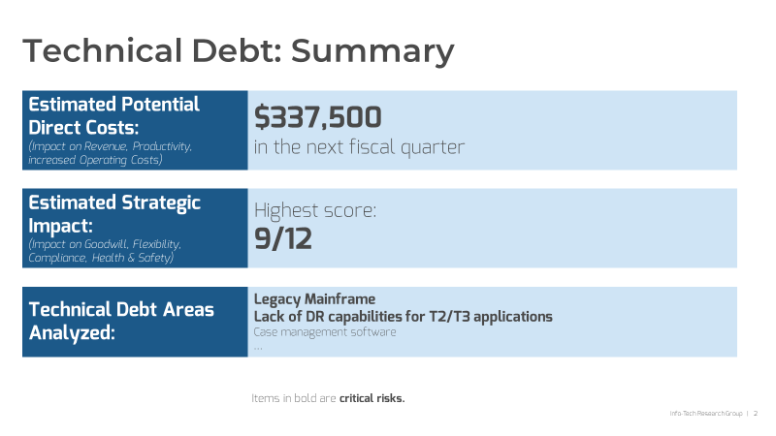


Make the case for change
Communicate the business risk of technical debt and potential mitigation options.
For (almost) the last time: the business must ultimately decide whether to accept or mitigate technical debt. This decision must be an informed decision – informed by IT’s business impact analysis and the list of prioritized options to address technical debt. Follow the instructions in the template to communicate the following:
A summary of the business risk of technical debt: A roll-up view of the impact of all assessed technical debt in your environment.
An overview of your methodology: An overview of the “Identify, Measure, and Manage” methodology you’ve followed in this blueprint.
Next steps: A one-page summary of each critical technical debt and three options to address each one. You may choose to include actions that can help you limit the amount of new technical debt you take on or minimize the impact of the debt you have, which you’ll identify in Step 3.2.
Download the Technical Debt Executive Summary Presentation template

Slide 59
Step 3.2
Insights & Outcomes
Track and control technical debt
Establish management practices that allow you to maintain a manageable and acceptable amount of technical debt that allows IT to continue meeting business demands.
This step will walk you through the following activities:
Review options to manage new technical debt and align ownership of technical debt properly.
Identify immediate next steps to improve how you manage the technical debt you have and to limit the amount of new tech debt you take on.
This step involves the following participants:
Tech Debt Exercise Facilitator
IT Management
IT SMEs
Phase 3:
Manage Your Technical Debt
3.1 Identify action items to reduce technical debt
3.2 Track and control technical debt

Slide 60

Get the technical debt monkeys off your back
The burden of managing tech debt does not belong on any one group’s shoulders alone.
Technical debt is a business risk. It is up the business to decide whether to mitigate or accept risk. Technical SMEs and IT management must identify and measure technical debt and propose options to manage technical debt, to enable the business to make good choices.
Better management practices will help you better avoid, identify, assess, and address technical debt. Different stakeholders have different roles to play.
Everyone’s responsible for surfacing technical debt when they find it; technical SMEs must identify options to address technical debt. Project teams are responsible for communicating technical debt that arises from unfinished or rescoped projects.
IT management is responsible for ensuring technical debt is tracked, prioritizing their team’s work and communicating technical debt and possible remediations to business decision makers where necessary.
The business is ultimately accountable to decide what action to take (if any) to address technical debt and to ensure that those actions are appropriately funded, resourced, and supported.

Slide 61
Adopt these six practices to manage existing technical debt, and slow down the introduction of debt
1 | Track new tech debt. Encourage teams to track smaller tech debt items in their own backlog; ensure new technical debt is identified at project closure.
2 | Improve architectural practices. Establish practices that identify the core structural elements of business systems, and ensure those elements remain in good order.
3 | Improve problem management practices to identify the root cause of recurring incidents.
4 | Budget for replacements. Spread out replacement cycles and set aside budget for technology replacements.
5 | Manage the time spent on maintenance activities. A high and increasing amount of time given to maintenance can be a sign that technical debt loads are too high.
6 | Continue to track and measure technical debt. If the business impact of technical debt starts to climb, take action to tighten up rules and limit the amount of new debt you take on or refocus on paying back the debt you have.

Slide 62

Track new and existing technical debt
Your business impact analysis is now your first technical debt register.
If you don’t keep track of your technical debt, you can’t manage it. Make your copy of the Technical Debt Business Impact Analysis Tool a living document and update it on a regular basis (e.g. quarterly or yearly). Validate the impact scores and update the list of technical debts as appropriate.
For lower-impact, but still important technical debt, delegate debt tracking to individual teams and their backlogs. Use Info-Tech’s research to Build a Better Backlog.
Ensure that incomplete work from project cycles is added to the backlog during the project closure process.
Don’t let project closure become an afterthought
An effective project closure process starts with intake, because completion criteria for a project should be first defined at intake. Use completion criteria to identify technical debt and make this a standard step in your project closure process. Use Info-Tech’s methodology, tools, and templates to manage project closure in such a way that you begin your projects with the end in mind.

Slide 63
Build better systems
“‘Architecture is about the important stuff. Whatever that is.’
On first blush, that sounds trite, but I find it carries a lot of richness. It means that the heart of thinking architecturally about software is to decide what is important, (i.e. what is architectural), and then expend energy on keeping those architectural elements in good condition. For a developer to become an architect, they need to be able to recognize what elements are important, recognizing what elements are likely to result in serious problems should they not be controlled.”
Martin Fowler,
Software Architecture Guide
Smart people solve problems. Wise people avoid them.
Humans can understand shifting needs in changing conditions and adapt to meet the demands of the moment. Technology isn’t like that. The more complex the technology, the more challenging it is to change quickly and effectively.
The future is inherently uncertain. In the face of uncertainty, it’s better to have flexible technologies that can adapt to the future you’re given than rigid systems that are built for a future you think you’ll have.
Architecture identifies the important, structural elements of the new and existing environment and sets the direction to keep those elements in good working order over time, to enable the agility required to accommodate new business demands. By managing important elements, you can more effectively balance changing business needs with cost-to-serve and technical serviceability, availability, reliability, and flexibility.
The role of architecture is to develop a holistic view of the “important elements” (e.g. security, risk & control, performance, fit-for-purpose, data, performance) and enable teams to build solutions that align with good design practices.
Better architecture helps manage technical debt. A holistic view of “good design” helps identify changes that undermine that design, explain the business impact of the change, offer improvements to align with design principles, and track issues that can’t be immediately fixed.

Slide 64

Identify root cause
Problem management can help you prevent technical debt fires before they burst into flame.
Problems are the underlying root cause of one or more actual or potential incidents. The Problem Manager is the fire marshal to the firefighting incident management team.
Problems and known errors are themselves a type of technical debt until they’re addressed. They can also be symptoms of a larger issue. For example, a high number of problems in a particular area could be a symptom of a larger technical debt. Problem management can be a starting point to identify previously unknown technical debt.
Problem management can also help inform the business impact analysis and make the case for action items to resolve technical debt. You can use data on the incidents caused by a particular problem to build a reasonable case to permanently address known but unresolved errors.
Tooling can help to identify and track potential issues, but effective processes and dedicated resource time to investigate and address problems is still absolutely required. Leverage Info-Tech’s methodology to improve both Incident and Problem Management.

Slide 65
Secure a technology replacement budget
Spread out replacement cycles. For example, rather than replacing every laptop in your fleet next year, plan for a gradual phase-out. Replace devices as they break, prioritize departments and groups that require PCs with higher specifications, and have spares for individual requests. Spreading out the spend can make it easier to secure budget and to allocate IT resources to the project.
Adopt a technique from personal finance: envelope budgeting. It’s a budget method where the cash for certain recurring monthly expenses is added to envelopes, preventing it from being spent elsewhere. Set aside required funds for replacement equipment each year to ensure funds are available when the replacement bill comes due.
Avoid letting equipment turn into technical debt.
It makes business sense to get all the value you can out of your purchased technology. The problem – that’s not always obvious to the business – is that you often stop getting value long before the technology breaks.
Consider a legacy physical server. While it still runs Windows XP as well as it ever did, it’s impossible to change, patch, or update it because it’s been out of support for so long. The business has identified a number of neat new features that would deliver value, but the system is so fragile you can’t make changes because no support’s available if it goes down. Because it can’t be patched, it’s an enormous security vulnerability and has to be isolated from the rest of the network.
You can reuse the impact analysis as needed to help you make the case for replacement. Use the tactics at right for large-scale, and plannable, technology updates.

Slide 66
Manage your maintenance
“I was in charge of a programming environment, which had been evolving for over 20 years. There was a lot of technical debt. And we got to the point where really we weren't putting out new features. And so, for a month, I had everyone record where their time went. And it turned out about 60 percent of their time coding was spent addressing technical debt or defects … if you added meetings, there was like five percent of overall time available for new work. It was brutal.
I got the GM to agree to do a release to address all the technical debt.
And our customers loved it! When we finally did the release, it was like ‘you’ve finally fixed all the problems that we’ve been hassling you about for years.’”
– Robert Fayle
Research Director, Applications Practice
Info-Tech Research Group
Too much maintenance is a symptom of too much technical debt.
Spikes in the time spent maintaining technology can serve as the canary in the coal mine that technical debt loads are becoming unsustainable and can help you make the case to reduce technical debt.
Accurately tracking time allocation can be challenging. Matrixed work structures, changing day-to-day demand, and interruption-driven work all interfere with productive project work and usable and reliable capacity data.
If you’re going to track maintenance time, make sure you have a process and an end-goal in mind.
Use Info-Tech’s methodology, tools and templates to Establish Realistic IT Resource Management Practices.

Slide 67

Mind the level of tech debt you own
Take steps to limit the introduction of any new technical debt when the amount you already have is high.
Because you’ll never get rid of it all, managing tech debt is a balancing act. You have to keep the impact of technical debt within manageable levels.
Think of managing technical debt like bailing out a leaky boat.
You can focus your energy on plugging the leaks (preventing new debt from entering the environment) or bailing out the water (getting rid of the existing debt). You have to do one or the other or at some point the boat will sink.
The goal is to tackle debt before it becomes an unacceptable drag on the business – and before repaying the debt is unmanageable.
Review and update the technical debt business impact analysis periodically. If your amount of debt reaches unacceptable levels, you may need to tighten rules for a period of time to avoid taking on new technical debt or redirect resources to paying more debt back.

Slide 68
3.2.1 Improve ongoing tech debt management
Input | Output
Technical debt management techniques Participant viewpoints Technical debt business impact analysis | Immediate next steps to improve tech debt management
Materials | Participants
Flip chart paper “Dot” stickers or whiteboard markers. Sticky notes | Tech Debt Exercise Facilitator IT Management IT SMEs
1 hour
Track new tech debt.
Improve architectural practices.
Improve problem management practices.
Budget for replacements.
Manage the time spent on maintenance activities.
Continue to track and measure technical debt.
Write out the six areas of focus for technical debt management, at right, on a whiteboard.
Give each participant three “dots” and ask them to vote on the area of focus most in need of urgent attention and improvement.
Take the two areas of improvement with the most dots. For each area, identify at least three actions you can take in the immediate future that can improve technical debt management.
Assign each next action to one of the participants.
Add any items that would need executive approval to your copy of the Technical Debt Executive Summary Presentation.

Slide 69



Related Info-Tech Research
Modernize Your Applications
Build your digital applications to support continuous modernization. Needs change rapidly, and customers and users expect software to follow suit. Create a vision for your application portfolio, define an approach to modernization, and build a roadmap to realize your vision.
Build an Infrastructure Roadmap
Infrastructure must position itself as the broker for new technologies. Who better to evaluate for fit, fitness, and risk? Create a roadmap that is a process, not a document; a framework for aligning business needs to supporting IT infrastructure projects.
Modernize Data Architecture
At the heart of the insights-driven enterprise is a modern data environment anchored in fit-for-purpose data architectures. Perform a diagnostic assessment of your architecture and identify a target state for your environment.

Slide 70

Craig Mueller
Four Anonymous Contributors
Global Director, IT Infrastructure & Operations
Craig Mueller is the Global Director of Infrastructure & Operations at HUSCO International. His primary focus is leading risk management programs to reduce technical debt and deliver disaster recovery solutions and business continuity initiatives.
Craig is an influential leader, working effectively with senior management to shape strategic direction and long-term vision. He is an expert in leading and completing business-critical, high-profile, complex projects while meeting administrative, regulatory, fiscal, budgetary, and contractual business system and process optimization.

Slide 71

Learn more about technical debt
Matt Eland at killalldefects.com has a series of good articles on technical debt as risk and on calculating, communicating, and paying back technical debt without doing harm, all from a development team’s perspective.
Watch Martin Fowler’s talk on architecture and read his thoughts on technical debt.
Read the original article by Ward Cunningham that introduced the technical debt metaphor and watch this video where he discusses the evolution of the idea.
Michael Feathers has written the classic book on the subject of taming technical debt in software, Working with Legacy Code. Find it at your favorite bookstore.
A research team at Google has written an article on a likely future problem for many organizations: “Hidden Technical Debt in Machine Learning Systems.”
Learn more about the power of metaphors, such as the technical debt metaphor, in this short video from George Lakoff, an expert on the topic.

Slide 72
Works Cited
Dalal et al. “Tech debt: Reclaiming tech equity.” McKinsey Digital, Oct. 2020. Accessed 9 Dec. 2020.
Deloitte. “How to Calculate Technical Debt.” The Wall Street Journal, 2015. Accessed 22 Nov. 2020.
Eland, Matt. “Technical Debt as Risk.” Kill All Defects, 24 Dec. 2019. Accessed 19 Nov. 2020.
Eland, Matt. “The True Cost of Technical Debt.” Kill All Defects, 9 Nov. 2019. Accessed 19 Nov. 2020.
Eland, Matt. “Communicating Technical Debt.” Kill All Defects, 1 Oct. 2019. Accessed 19 Nov. 2020.
Eland, Matt. “Strategies for Paying Off Technical Debt.” Medium: The Startup, 2 Oct. 2019. Accessed 19 Nov. 2020.
Eland, Matt. “Addressing Tech Debt without Killing Quality.” Kill All Defects, 5 Oct. 2019. Accessed 19 Nov. 2020.
Fowler, Martin. “TechnicalDebt.” MartinFowler.com, 21 May 2019. Accessed 19 Nov. 2020.
Fowler, Martin. “Software Architecture Guide.” MartinFowler.com, 9 Aug. 2019. Accessed 19 Nov. 2020.
Koskinen, Jussi. “Software Maintenance Costs.” School of Computing, University of Eastern Finland, Joensuu, Finland: 30 Apr. 2015. Accessed 15 Nov. 2020.
Martini, Antonio et al. "Technical Debt Tracking: Current State of Practice." Science of Computer Programming, vol 163, 2018, pp. 42-61. Elsevier BV, doi:10.1016/j.scico.2018.03.007. Accessed 19 Nov. 2020.
Pratchett, Terry. Wintersmith. Corgi Books, 2007.
Scully, D., et al. “Hidden Technical Debt in Machine Learning Systems.” Advances in Neural Information Processing Systems, edited by C. Cortes et al., vol. 28, Curran Associates, Inc., 2015, pp. 2503–2511. Accessed 19 Nov 2020.

